Slide 1


Go Faster Sooner! Discover SQL Server index prescriptions for the biggest performance improvements
SQLSaturday #1098
December 7th, 2024
Bill Sanscrainte Bill@Sanscrainte.com
Get this presentation, Excel spreadsheet, & T-SQL code at
https://github.com/SQLXL/SQLXL
Notes:
*00:00*

Slide 2






Thank our Sponsors!
Notes:
*00:15*

Slide 3



November 17- 21, 2025 in Seattle, WA
https://passdatacommunitysummit.com/

Slide 4

About Me
Bill Sanscrainte linkedin.com/in/billsanscrainte Bill@Sanscrainte.com
SQL Server since 6.5
1984 - Executed first SQL statement
1994 - Started Data Consulting practice
2001 - Began version 1 of SQLXL tools
2020 - Retired to pursue SQL Server passion projects
Record holder for most SQL Cruises as a student SQL Server 10 Oracle 2
* Ask questions at any time! *
Notes:
*00:30*

Slide 5

Why are we here?
“Poorly designed indexes and a lack of indexes are primary sources of database application bottlenecks”
learn.microsoft.com 07/26/2024
Notes:
*01:30*

Slide 6

My Index Tuning Journey
Early Days
Download SQL Community scripts, copy/paste results, seek actionable nuggets
Building Skills
Linked SQL Server to Excel to better accumulate scripts & results
Combined “best of” community scripts
Added metadata, foreign keys, missing indexes, usage metrics, statistics
Included specialty index details, history tables, internal tables
Glued it all together by table & index
Today’s Agenda … SQLXL_Index
Integrate meaningful diagnostics
Prescribe index-level activities
Prioritize index tuning actions
Start with tuning indexes?
Agenda

Slide 7

Client Story - Once Upon a Time
Business: Membership & Event Management services
Application: Has “always” been “slow” and getting “slower”
Problem: SQL Server “failed” when really busy
Consultant : Where do we start?
Notes:
*02:20*
Restarted server
3 days to recover - untangle members, events, and payments
Lost several big customers
Begin by asking focusing Questions
AWS via “Lift & Shift” from on-premise
SQL 2016 Enterprise
32 cores / 240GB RAM 2TB data
No SQL monitoring tools

Slide 8

Where do We Start?
Hardware - any money?
Refactor - any staff not committed to high priorities?
Database
Indexes been “tuned” “recently”?
Activity peaks random?
CPU grows exponentially as users grow linearly?
“Poison” SQL wait types? - RESOURCE_SEMAPHORE, THREADPOOL
“Lots” SOS_SCHEDULER_YIELD waits?
“High” Lock & Latch waits?
Maintenance window too big?
Missing index / Data Tuning Advisor recommendations applied “often”?
Notes:
Hardware - money Changes work on existing hardware. Just takes longer
Refactor - Staff committed Application refactoring will take much longer
Database - IDX tuned The universal condition
Activity peaks Changes be done individually, start with highest priority
CPU grows exponentially Queries getting in each others way
“Poison” wait types Less memory & CPU available for next query
SOS_SCHEDULER_YIELD SQL shuffling work between CPUs & task queues
Lock & Latch waits Too many/too few indexes & waiting on lock escalations
SQL maintenance Enterprise - changes can be made online - no outage
MIX / DTA Lots of redundancy

Slide 9

Client Signs We Should Start With Index Tuning
10/10
Let’s tune indexes!
Notes:
*06:15*

Slide 10

Prioritizing Index Tuning
Pareto Principle (or the “80/20 Rule”)
80% of results from 20% of effort
How do we apply Pareto’s Principle to indexes?
SQL Server tracks performance “hurts” by index
Add up “hurts” by table
Fix biggest “hurting” table first
Notes:
*07:20*
HURT = Costs to Create, Read, Update, Delete (“CRUD”) data in tables

Slide 11

Client Story - Index Tuning Priorities
82% of hurt
4% of tables
Notes:
*07:50*
21 tables
Stunning insight - a lot less work to make significant improvement in performance
YMMV

Slide 12
SQLXL_Index Hurt Visualization
Priorities!
Notes:
*14:30*
*06:00*
Hundreds of columns
Dropdown
Hurts - color coded
*SORTS*
Table Name
Object Types
Hurt PCT - color coded

Slide 13
Hurt Metrics - Grouping
Waits Locks Splits Merges Missing Writes | Buffer Read/write Scans Lookups Fetches LOB
Notes:
*8:00*
Nearly 80 metrics of measured HURT
Lumped into 12 broad categories
INCOMPLETE - Fulltext, columnstore, in-memory
avg_system_impact
avg_total_system_cost
avg_total_user_cost
avg_user_impact
buffer_total_KB
column_value_pull_in_row_count
column_value_push_off_row_count
delete_buffer_scan_count
forwarded_fetch_count
index_lock_promotion_attempt_count
index_lock_promotion_count
index_scan_count
in_row_reserved_page_count
io_wait_time_in_ms
key_merge_count
key_merge_retry_count
key_split_count
key_split_retry_count
leaf_allocation_count
leaf_delete_count
leaf_ghost_count
leaf_insert_count
leaf_page_merge_count
leaf_update_count
lob_fetch_in_pages
lob_orphan_create_count
lob_orphan_insert_count
lob_reserved_page_count
new_log_wait_time_in_ms
nonleaf_allocation_count
nonleaf_delete_count
nonleaf_insert_count
nonleaf_page_merge_count
nonleaf_update_count
page_consolidation_count
page_consolidation_retry_count
page_io_latch_wait_count
page_io_latch_wait_in_ms
page_latch_wait_count
page_latch_wait_in_ms
page_lock_count
page_lock_wait_count
page_lock_wait_in_ms
page_merge_count
page_merge_retry_count
page_split_count
page_split_retry_count
page_update_count
page_update_retry_count
range_scan_count
reserved_page_count
row_delete_attempts
row_group_lock_count
row_group_lock_wait_count
row_group_lock_wait_in_ms
row_insert_attempts
row_lock_count
row_lock_wait_count
row_lock_wait_in_ms
row_overflow_fetch_in_pages
row_overflow_reserved_page_count
row_update_attempts
singleton_lookup_count
system_lookups
system_scans
system_seeks
total_wait_time_in_ms
tree_page_io_latch_wait_count
tree_page_io_latch_wait_in_ms
tree_page_latch_wait_count
tree_page_latch_wait_in_ms
unique_constraint_violations
user_lookups
user_scans
user_seeks
waits_for_io_count
waits_for_new_log_count
write_conflicts

Slide 14

Hurt Metrics
Waits
Locks
Splits
Merges
Missing
Writes
Buffer
Read/Write
Scans
Lookups
Fetches
LOB
Requested index action waited for another SQL activity to complete
Measure: count sum of wait time
Notes:
*06:00*

Slide 15

Hurt Metrics
Waits
Locks
Splits
Merges
Missing
Writes
Buffer
Read/Write
Scans
Lookups
Fetches
LOB
Controls for transactional compliance with ACID requirements
Measure: count of locks count of attempted lock promotions count of promotion success/fail
Notes:
*08:45*
ACID - atomicity, consistency, isolation, durability

Slide 16

Hurt Metrics
Waits
Locks
Splits
Merges
Missing
Writes
Buffer
Read/Write
Scans
Lookups
Fetches
LOB
Inserted / updated data won’t fit into an existing data page
create new page
splinter data between pages
Measure: count
Notes:
*09:15*
column_value_push_off_row = to LOB storage

Slide 17

Hurt Metrics
Waits
Locks
Splits
Merges
Missing
Writes
Buffer
Read/Write
Scans
Lookups
Fetches
LOB
Row deletion or column update frees up space
squeeze data pages together
emptied page marked for ghost cleanup
Measure: count
Notes:
*09:45*
column_value_pull_in_row = from LOB storage

Slide 18

Hurt Metrics
Waits
Locks
Splits
Merges
Missing
Writes
Buffer
Read/Write
Scans
Lookups
Fetches
LOB
SQL optimizer suggests a new index to improve performance
Measure: query cost estimate estimated query cost savings count of executions
NOTE: comes with many limitations
Notes:
*10:15*

Slide 19

Missing Index Limitations (from Microsoft)
Only considers nonclustered, rowstore, disk-based indexes
No clustered, columnstore, in-memory, partitioned, compressed, XML, spatial, full-text, hash, unique, filtered, materialized views …
Only creates estimates from a single query optimization
Cleared for a table on DDL change or index add/change/delete/rebuild
First 600 only, any additional ignored
Key column selectivity ignored, keys listed by table column creation order
Does not consider existing nonclustered columnstore in deciding on a “missing” index
No consideration for key column parameter sniffing
Query metrics are not updated after actual execution(s)
Not weighted based on total number of times table was accessed
Adds included columns to cover query, without weighing cost / benefit ratio
No knowledge of existing indexes or other recommendations - creates overlaps!
No suggestions for trivial (“simple”) query plans
Suggests missing indexes for imprecise and non-persisted computed columns
Only one returned from each query, even if many were suggested in plan XML
Queries with only inequality predicates have less accurate query cost
Ignores internal tables (e.g. supporting full text & spatial indexes)
Ignores history tables (CDC, SVN, LDG)
Notes:
*10:45*

Slide 20

Hurt Metrics
Waits
Locks
Splits
Merges
Missing
Writes
Buffer
Read/Write
Scans
Lookups
Fetches
LOB
Changes to table & index data
Measure: count
Notes:
*11:30*

Slide 21

Hurt Metrics
Waits
Locks
Splits
Merges
Missing
Writes
Buffer
Read/Write
Scans
Lookups
Fetches
LOB
Proportion of table / index / heap in the buffer cache
exclude in-memory objects (always 100%)
Measure: ratio of
pages in memory
allocated reserved pages
Notes:
*12:00*

Slide 22

Hurt Metrics
Waits
Locks
Splits
Merges
Missing
Writes
Buffer
Read/Write
Scans
Lookups
Fetches
LOB
“Gooder” indexes are read way WAY more than written
Benchmark: read > 4X writes because writes do more:
Transaction Locks & Exclusive Latches
Uniquifiers/RIDs (Row IDentifiers)
Sequence/identity generation
Splits & merges
Deletes & Ghost cleanup
Data file I/O
Log file I/O
Change/History Table inserts
Replica synching
Measure: ratio of Reads
Writes
Notes:
*12:30*

Slide 23
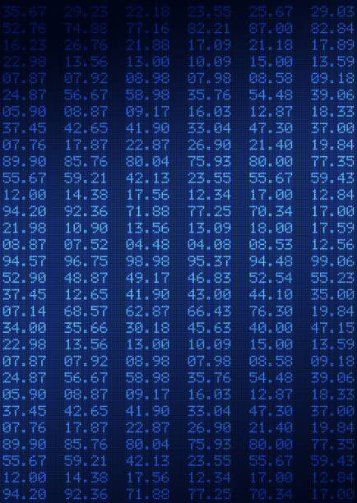
Hurt Metrics
Waits
Locks
Splits
Merges
Missing
Writes
Buffer
Read/Write
Scans
Lookups
Fetches
LOB
Start at the top and read all pages
until you hit bottom
or TOP (###)
if index keys match ORDER BY
Measure: count
Note: Columnstore is scan only
Notes:
*13:00*
“Better” indexes get ”Seeked” - still may involve scan from that point
Or TOP (###) - if index keys match ORDER BY columns

Slide 24

Hurt Metrics
Waits
Locks
Splits
Merges
Missing
Writes
Buffer
Read/Write
Scans
Lookups
Fetches
LOB
Index keys & included columns don’t “cover” query needs
extra seek(s) to data row
Measure: count
Notes:
*13:30*
“Better” indexes get ”Seeked” - still may involve scan from that point

Slide 25

Hurt Metrics
Waits
Locks
Splits
Merges
Missing
Writes
Buffer
Read/Write
Scans
Lookups
Fetches
LOB
Heap Table - updating record causes page split
data physically moved out of original insertion sequence
pointers created to maintain data order
Measure: count of forward fetched rows
Notes:
*14:00*
corrected by creating clustered index -or- table rebuild

Slide 26

Hurt Metrics
Waits
Locks
Splits
Merges
Missing
Writes
Buffer
Read/Write
Scans
Lookups
Fetches
LOB
Big data types
TEXT, NTEXT
IMAGE
VARCHAR(MAX), NVARCHAR(MAX)
VARBINARY(MAX)
XML
Maintained in off-row pages
separate data allocation units
extra maintenance for pointers
Measure: count of writes & reads
Notes:
*22:00*
Special data allocations: LOB_DATA & ROW_OVERFLOW_DATA

Slide 27

Hurt Weighting - Runtime parameters - Current Defaults
Waits ++++++
Locks +++
Splits +++++
Merges +++++
Missing ++++
Writes +++
Buffer +++++
Read/write ++++
Scans ++++
Lookups ++
Fetches +++
LOB +
Notes:
*20:30*
Parameterized in SQLXL_Index
19 different values
Reflect your server’s operational metrics
Aggregated to Table level

Slide 28
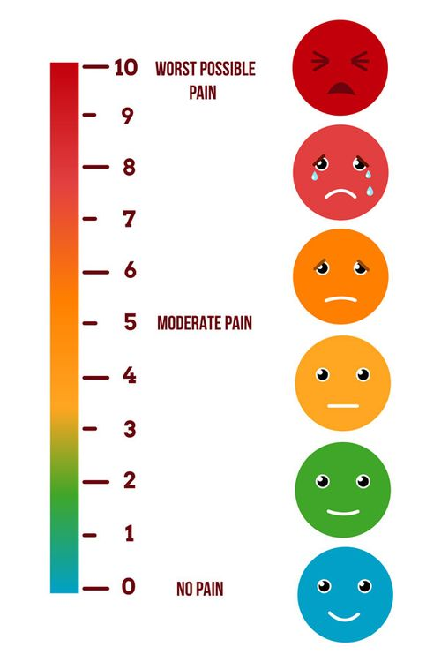
Prioritizing the Hurt – Applying Weighting
For each hurt metric
Add up index hurts to table
Total all tables
Compute each table’s percent of total
Apply hurt weighting factor
Total up weighted metrics by table
Present results in descending order of hurt
Notes:
*21:15*
Why by table - it’s where the data lives

Slide 29

Client Story - What do We Do?
The 21 (4%) prioritized tables makes sense, but …
What do we do next?
Notes:
*22:00*

Slide 30
SQLXL_Index Prescriptions
Prescriptions!
Notes:
*14:30*
*06:00*
Hundreds of columns
Dropdown
Hurts - color coded
*SORTS*
Table Name
Object Types
Hurt PCT - color coded

Slide 31

Making the Hurt Go Away - Prescriptions
100+ table and index prescriptions
Grouped into 8 action categories
Notes:
*29:15*
What are the 8 things you can do the indexes on a table?

Slide 32
Make the Hurt Go Away - Prescription Categories
Retain Replace Request Reject | Remove Review Refresh Refactor
Notes:
*29:30*

Slide 33
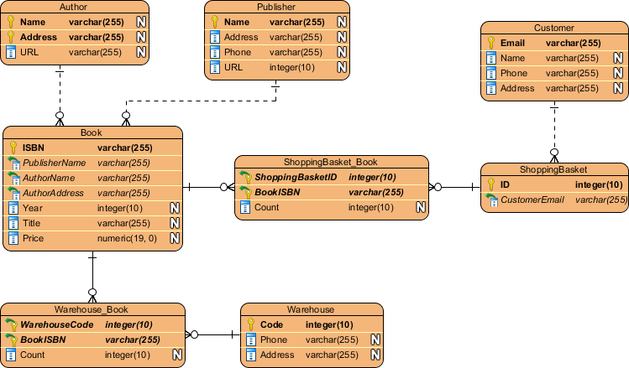
Prescription Categories
Retain
Replace
Request
Reject
Remove
Review
Refresh
Refactor
Keep existing indexes “As Architected & Designed”
Clustered
Constraints - primary key, unique, foreign key
Specials - full-text, spatial, XML, columnstore, hash
History - Change Data Capture, System Versioned, Ledger
Internal Tables
Required by others
e.g. unique index supporting full-text
Notes:
*29:45*

Slide 34

Prescription Categories
Retain
Replace
Request
Reject
Remove
Review
Refresh
Refactor
New in SQL 2016+ Enterprise: updatable nonclustered columnstore
Replace existing nonclustered rowstore indexes
Low usage
Low read/write ratio
Missing indexes
Notes:
*30:15*

Slide 35

Prescription Categories
Retain
Replace
Request
Reject
Remove
Review
Refresh
Refactor
Create New Index
Clustered indexes on used heaps
Valuable missing indexes
Foreign key covers
Updatable nonclustered columnstores (SQL 2016E+)
Notes:
*30:45*

Slide 36

Prescription Categories
Retain
Replace
Request
Reject
Remove
Review
Refresh
Refactor
Missing index recommendations
That don’t add significant value
Covered by nonclustered columnstore
Notes:
*31:15*
Especially once weighted by share of reads

Slide 37

Prescription Categories
Retain
Replace
Request
Reject
Remove
Review
Refresh
Refactor
Drop existing nonclustered rowstore indexes
Cost more than benefit - less than 4 reads per write
Least used Duplicate
Redundant foreign key constraint
Notes:
*31:45*
Same keys different sequence (“overlap”)
Keys “contained” in another bigger index

Slide 38

Prescription Categories
Retain
Replace
Request
Reject
Remove
Review
Refresh
Refactor
“It Depends” for indexes tagged previously - like:
Potential filtered index - wide range of rows per lead index key
Non-persisted computed column in index
Potential temporary based on name
High page compression failures
Disabled / Not trusted
Synergies & overlaps
Notes:
*32:15*

Slide 39

Prescription Categories
Retain
Replace
Request
Reject
Remove
Review
Refresh
Refactor
Refresh index statistics with
row modification counts
row count not matching table row count
Rebuild / reorganize columnstores with
delta stores (update, delete)
multiple undersized rowgroups
Notes:
*32:45*

Slide 40

Prescription Categories
Retain
Replace
Request
Reject
Remove
Review
Refresh
Refactor
Retained indexes benefiting from structural changes:
Rowstore index - more key(s) don’t improve selectivity
FILL FACTOR = 100% with hi page splits (and opposite)
Index partition not match table partition
Collation mismatch
Page / row locking not enabled
Clustered rowstore index not “NUSE”
Narrow
Unique
Static
Ever increasing
Notes:
*33:15*

Slide 41

Client Story - Implement Prescriptions & Measure Improvement
Disable index and statistics maintenance jobs
Reduce index metric resets
Weekly maintenance restart & run business
At end of week build “before” baseline
Apply prescriptions to 4% (21) of tables
Weekly maintenance restart & run business
End of week capture “after” statistics
Compare “after” to “before”
Note: “mostly similar” non-peak workloads
Notes:
*33:45*
Fixes applied & server restarted

Slide 42

Client Story - SQL Wait Improvements versus Previous Week
System Waits
RESOURCE_SEMAPHORE -71%
THREADPOOL -67%
SOS_SCHEDULER_YIELD -63%
LCK_* & PAGELATCH_* -52%
Index Hurts
Waits - times & counts -77%
Locks - count, promotions -62%
Scans & lookups -58%
Read / Write ratio -47%
Writes -43%
Splits, merges, LOB -39%
Buffer cache usage - 0%
Notes:
*34:45* YMMV
Why not 80% - exposed next level of waits & hurts

Slide 43
SQLXL_Index Diagnostics
Diagnostics!
Notes:
*38:00*
*04:15*
Squeeze! Into smallest possible space
Avoid scrolling

Slide 44

Why are We Doing It? - 485 Diagnostics (SQL version aware)
“Good to know”- like
Dates: Last read / written / modified / created / statistics updated …
“Key” configuration properties
server, instance, database, query store …
Items that “stand out” - like
Non-default properties, settings, parameters
High proportion of a hurt or other metric
e.g. waits, locks, splits, merges
Anti-Patterns - like
Big included columns
Uncovered foreign keys
with missing index recommendations
Link to Brent Ozar’s sp_BlitzIndex “Checks” (58)
Notes:
*37:00*
Non-Default - Cost threshold for Parallelism
History and Internal Tables given a pass (mostly)
Version Aware - don’t ding SQL 2012 for new feature in SQL 2022
Link to BlitzIndex when same item found (58 items)

Slide 45
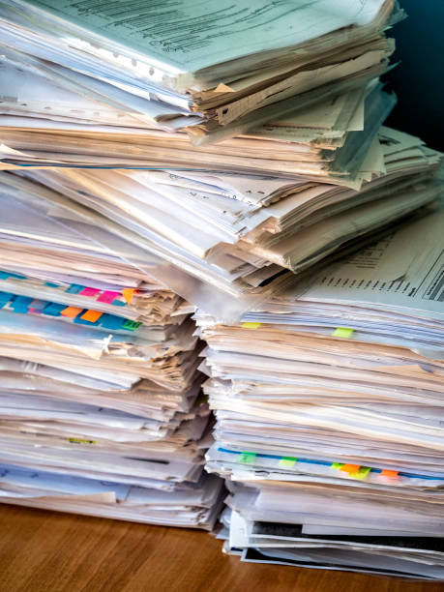
What about Index Metadata and Other Metrics?
Hundreds of columns - details on
Index keys & included columns
Foreign key constraints
Table & column constraints
Statistics names and filter definitions
Extended properties
All Usage metrics
All Operational metrics
including in-memory & columnstore
Metadata - index, table, database, instance
Notes:
*42:15*

Slide 46

SQL Server Ingredients
89 DMVs & DMFs
925 columns
238 configurations & settings
182 performance & hurt metrics
Notes:
*36:00*
How did we come up with prescriptions? We diagnosed the symptoms.

Slide 47

SQL Server Ingredients
Server @@ Functions DBCC TRACESTATUS sys.availability_replicas sys.change_tracking_databases sys.database_scoped_configurations sys.databases sys.dm_db_index_operational_stats sys.dm_db_index_usage_stats sys.dm_db_missing_index_columns sys.dm_db_missing_index_details sys.dm_db_missing_index_group_stats sys.dm_db_missing_index_group_stats_query sys.dm_db_missing_index_groups sys.dm_exec_query_plan sys.dm_exec_query_stats sys.dm_exec_sessions sys.dm_exec_sql_text sys.dm_hadr_availability_replica_states sys.dm_os_buffer_descriptors sys.dm_os_sys_info SERVERPROPERTY Function | Database cdc.change_table sys.allocation_units sys.change_tracking_tables sys.check_constraints sys.column_store_row_groups sys.column_type_usages sys.columns sys.computed_columns sys.data_spaces sys.database_automatic_tuning_options sys.database_files sys.database_query_store_options sys.database_scoped_configurations sys.default_constraints sys.dm_db_column_store_row_group_operational_stats sys.dm_db_column_store_row_groups sys.dm_db_column_store_row_group_physical_stats sys.dm_db_incremental_stats_properties sys.dm_db_partition_stats sys.dm_db_stats_properties sys.dm_db_xtp_hash_index_stats sys.dm_db_xtp_index_stats sys.dm_db_xtp_memory_consumers sys.dm_db_xtp_Nonclustered_index_stats sys.dm_db_xtp_object_stats sys.dm_db_xtp_table_memory_stats sys.dm_sql_referencing_entities sys.dm_xtp_system_memory_consumers sys.edge_constraint_clauses sys.edge_constraints sys.extended_properties sys.filegroups | sys.foreign_key_columns sys.foreign_keys sys.fulltext_catalogs sys.fulltext_index_columns sys.fulltext_indexes sys.hash_indexes sys.identity_columns sys.index_columns sys.index_resumable_operations sys.indexes sys.internal_partitions sys.internal_tables sys.key_constraints sys.objects sys.partition_functions sys.partition_schemes sys.partitions sys.schemas sys.sequences sys.spatial_index_tessellations sys.spatial_indexes sys.sql_expression_dependencies sys.sql_modules sys.stats sys.stats_columns sys.table_types sys.tables sys.triggers sys.types sys.views sys.xml_indexes sys.xtp_memory_consumers sys.xtp_nonclustered_index_stats sys.xtp_object_stats
Notes:
*36:45*

Slide 48

Execution
38 seconds on client
Parameters
Single / User / All databases
Foreign Key Covering
Create Nonclustered Columnstore
Hurt weightings (17)
Versions
Boxed product 2012+
Azure SQL DB & Managed Instance
Notes:
*36:00*
How did we come up with prescriptions? We diagnosed the symptoms.

Slide 49

Applying Index Fixes
Create 2 clones of database structure (1 for current state, 1 to make changes to)
Apply changes to clone & create delta scripts using DDL comparison tool
Plan for tons of log file
Incrementalism - batch changes by table
Expedites (inevitable) rollbacks
Consider DISABLE before dropping
Check secondary before dropping!
Apply delta scripts to target database
Re-compare “end state” to target database
Address any discrepancies
Create “rollback” from clone if SHTF
Notes:
*47:30*
Depending on where problem occurs at what stage in the process, rollback code may be incomplete
Many DDL comparison tools batch up all related activities - can be difficult to unwind if failure

Slide 50

Client Story - They Lived Happily Ever After
Good News - even bigger event SQL CPU max 32%, no issues reported
More better - No performance complaints!
Completed most of the remaining index prescriptions, including:
Replaced least-used indexes with nonclustered columnstores
Removed
indexes not adding value
Redundant/overlap indexes
Requested
high-value missing indexes
clusters on heaps
foreign key covers
Notes:
*50:30*

Slide 51

Special thanks to these and other SQL community contributors!
Brent Ozar Kevin Kline Jes Borland Tom Collins Erik Darling Glenn Berry Gail Shaw Pedro Lopes Dave Bland | Tim Ford Sean McCown Kendra Little Pinal Dave Phil Factor Kalen Delaney Jason Strate Jared Westover Percy Reyes | Grant Fritchey Andy Yun Paul Randall Kimberly Tripp Edward Pollack Ahmad Yaseen Evgeniy Gribkov Ola Hallengren Denny Cherry | Aaron Bertrand Jonathan Kehayias Dmitri Korotkevitch Niko Neugebauer Monica Rathbun Kendall vanDyke Thomas LaRock Torsten Strauß Rebecca Hirschfield
Notes:
*53:45*
Shout out to these and others whose community contributions went into this presentation

Slide 52

Free Stuff!
Up to 8 hours free consulting!
Notes:
*51:30*

Slide 53

Questions?
Notes:
*54:00*
Questions?

Slide 54

Please fill out the Session Evaluation!
Notes:
*58:50*
Session Evaluations

Slide 55
Thanks for coming!
Bill Sanscrainte
linkedin.com/in/billsanscrainte & Bill@Sanscrainte.com
Presentation, spreadsheet, & T-SQL
https://github.com/SQLXL/SQLXL
Also See:
Brent Ozar’s sp_BlitzIndex
Glenn Berry’s 89 (2022) Diagnostic Information Queries
Aaron Bertrand’s 40 table property queries
Book: Expert Performance Indexing in Azure SQL and SQL Server 2022
Link to sp_Blitz_Index Checks:
https://github.com/BrentOzarULTD/SQL-Server-First-Responder-Kit/blob/dev/Documentation/sp_BlitzIndex_Checks_by_Priority.md
Notes:
59:00

